Slide 1


Arowwai Industries
CASE STUDY: SUCCESSFUL CONTAINERIZATION PROJECTS
GROUP ACTIVITY PRESENTATION

Slide 2


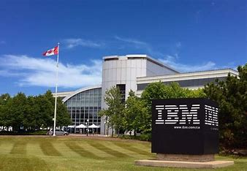

International Business Machines (IBM) Corporation
Nokia Oyj
AIRBNB, INC.

Slide 3

Case Study
AN OVERVIEW OF THE CASE STUDY
Faced with the need to support over 1,000 engineers deploying critical services concurrently, Airbnb turned to Kubernetes to enhance scalability and streamline continuous delivery. The goal was to allow these engineers to add and configure services quickly, leveraging Kubernetes to horizontally scale continuous delivery and automate common workflows.
LEARN MORE

Slide 4


PROBLEMS, SOLUTIONS & OUTCOMES
Case Study
01. Problem
Airbnb’s migration to Kubernetes addressed several challenges they faced in scaling and managing deployments with over 1,000 engineers. They required an infrastructure to handle large-scale continuous delivery, simplify service configuration, and improve deployment management for over 250 services.
02. Solution
Included adopting Kubernetes for abstraction and consistency across environments, using Kube-gen to automate the generation of configuration files from a single source, and creating standardized repositories with templates for applications, CI/CD, and infrastructure. This approach ensured configurations were validated and consistent from the start.
03. Outcomes
Airbnb achieved enhanced deployment velocity, averaging over 500 deployments per day, with reliable, standardized workflows. The new system also streamlined engineers' workflows, enabling faster, more agile development across teams.
This case highlights how Kubernetes can address large-scale deployment and configuration issues, supporting both growth and operational efficiency.

Slide 5
Case Study
KEY LESSONS
Scalability & Continuous Delivery
Deployment Velocity
Kubernetes allowed Airbnb to support large teams deploying high-frequency updates across multiple services, creating an infrastructure for scalable, unified configurations with namespaces and automated validations.
Kubernetes enabled Airbnb to reach over 500 deployments daily, showcasing how managed infrastructure can support high deployment speed without sacrificing stability.
Efficiency Through Abstractions
Support for Multi-Service Environments
Standardizing configurations allowed engineers to focus on development rather than repetitive setup, enhancing productivity and collaboration across teams.
Kubernetes’ orchestration tools enabled efficient management of over 250 critical services, reinforcing its capability for high-concurrency, multi-service operations.

Slide 6
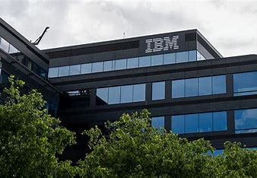
Case Study
AN OVERVIEW OF THE CASE STUDY
In late 2017, IBM Cloud aimed to enhance security by developing an image trust service to ensure the integrity and provenance of container images, leading to the launch of Portieris in February 2018. Built on the CNCF open-source project Notary, Portieris functions as a Kubernetes admission controller that enables users to establish image security policies at various levels, integrating seamlessly with IBM's Notary service to verify container images. This implementation significantly improves security by allowing users to sign images in private registries, supporting fine-grained deployment policies in CI/CD pipelines. Portieris is highly available across five regions with load balancing, failover support, and end-to-end TLS for secure communication. IBM is actively involved in the CNCF community, contributing to open-source projects and enhancing Notary. Michael Hough advises companies to focus on high availability and community engagement when deploying Notary or cloud-native infrastructure, showcasing IBM's commitment to security and collaboration in the cloud-native ecosystem.

Slide 7
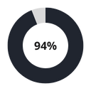
Case Study
PROBLEMS, SOLUTIONS & OUTCOMES
Problem: IBM Cloud’s diverse services include public, private, and hybrid cloud offerings, which needed enhanced security measures for image integrity and provenance. In late 2017, IBM’s Container Registry team aimed to address this by building an image trust service capable of enforcing secure and trusted container deployments on Kubernetes.
Solution: IBM developed Portieris, an image trust service based on CNCF’s Notary, launching it in early 2018. Portieris acts as a Kubernetes admission controller that allows users to set and enforce image security policies at both namespace and cluster levels, integrating with IBM’s Notary service to verify that container images meet security standards. IBM deployed Portieris across five regions with load balancing, failover support, and TLS-backed connections to IBM Cloudant, ensuring high availability and robust data security.
Outcomes: Portieris significantly boosted IBM Cloud's security by allowing users to sign images in private registries, adding assurances of image origin and integrity. The solution also introduced granular deployment policies for CI/CD pipelines, giving enterprises precise control over deployments. IBM’s commitment to open-source collaboration strengthened CNCF projects like Notary and TUF, contributing advancements such as a CouchDB backend and broadening support for security hardware. This initiative has underscored IBM’s dedication to secure, open-source cloud-native infrastructure, benefiting security-conscious customers and establishing IBM as a proactive contributor within the CNCF ecosystem.

Slide 8
Case Study
KEY LESSONS
Adopt Proven Security Standards
Prioritize High Availability
Use trusted, community-supported tools like Notary to streamline security and reduce proprietary development.
Deploy across multiple regions with load balancing and failover to ensure reliability and fault tolerance for critical security services.
Engage in Open Source Communities
Ensure Security Hardware Compatibility
Contributing to CNCF projects fosters collaboration, innovation, and the development of industry standards.
Strengthening authentication processes requires tools to support diverse security hardware, meeting stringent enterprise security needs.

Slide 9

Case Study
AN OVERVIEW OF THE CASE STUDY
Nokia faced the challenge of delivering telecom software across various infrastructures, including bare metal, virtual machines, and cloud environments like VMware and OpenStack. To ensure seamless operation without the need for product modifications for each environment, Nokia transitioned to cloud-native technologies, primarily Kubernetes.
LEARN MORE

Slide 10

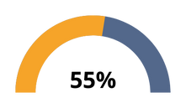
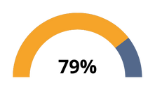
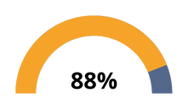
Case Study
PROBLEMS, SOLUTIONS & OUTCOMES
Problems: Nokia faced the challenge of delivering software across various telecom operators that utilized different infrastructures, including bare metal, virtual machines, and cloud environments (e.g., VMware and OpenStack). This diversity complicated the deployment process as each operator required adaptations of the software.
Solutions: To tackle these challenges, Nokia decided to embrace cloud-native technologies, specifically Kubernetes. They began experimenting with Kubernetes in its early versions, recognizing its potential for scalability and stability. The first product to leverage Kubernetes was the Nokia Telephony Application Server, launched in early 2018, leading to a broader architectural shift for all products towards Kubernetes.
Outcomes: The implementation of Kubernetes has facilitated Nokia's transition into 5G technology. By decoupling the infrastructure from the application layer, teams have seen a reduction in system dependencies, making it easier to implement new features. Additionally, the ability to test the same binary artifacts across various environments has improved error detection during early testing phases. This change has led to significant time savings, with hundreds of hours saved in each release cycle.

Slide 11
Case Study
KEY LESSONS
Early Adoption of Cloud-Native Technologies
Improved Testing Processes
Nokia's proactive engagement with early Kubernetes versions illustrates the benefits of staying ahead of technological trends, which is crucial in rapidly evolving sectors like telecommunications.
Testing the same binary artifacts in multiple environments streamlines workflows and enhances early error detection, leading to faster release cycles.
Significant Time Savings
Focus on Future-Proof Technologies
Kubernetes implementation has resulted in hundreds of hours saved per release by optimizing processes and boosting team efficiency.
Aligning with forward-looking technologies, such as those needed for 5G, positions organizations for future advancements and industry shifts.

Slide 12

Case Study
THANK YOU!
Members:
Dan Keneth M. Rontale
Nicolle Gutierez
Rhigen Abaca

